Slide 1
Mysterious Moose and Where to Find Them
Caitlin Eaton, Tim Maron, Ed Zellar, Kaitlyn Lanning, Sim Yee Siew, Connor Fallon

Slide 2
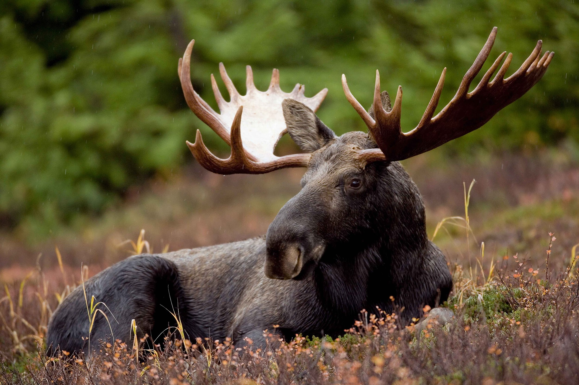
Question/Intro:
Why are there fewer moose in the Adirondacks compared to areas of similar geography, temperature, and vegetation like Vermont or New Hampshire?
As a large ungulate, moose have a large target on their back when it comes to predation, habitat fragmentation, carrying capacity and human interactions. By the end of this presentation, we will answer the question: why are moose not thriving in the Adirondacks.
Notes:
Sim

Slide 3
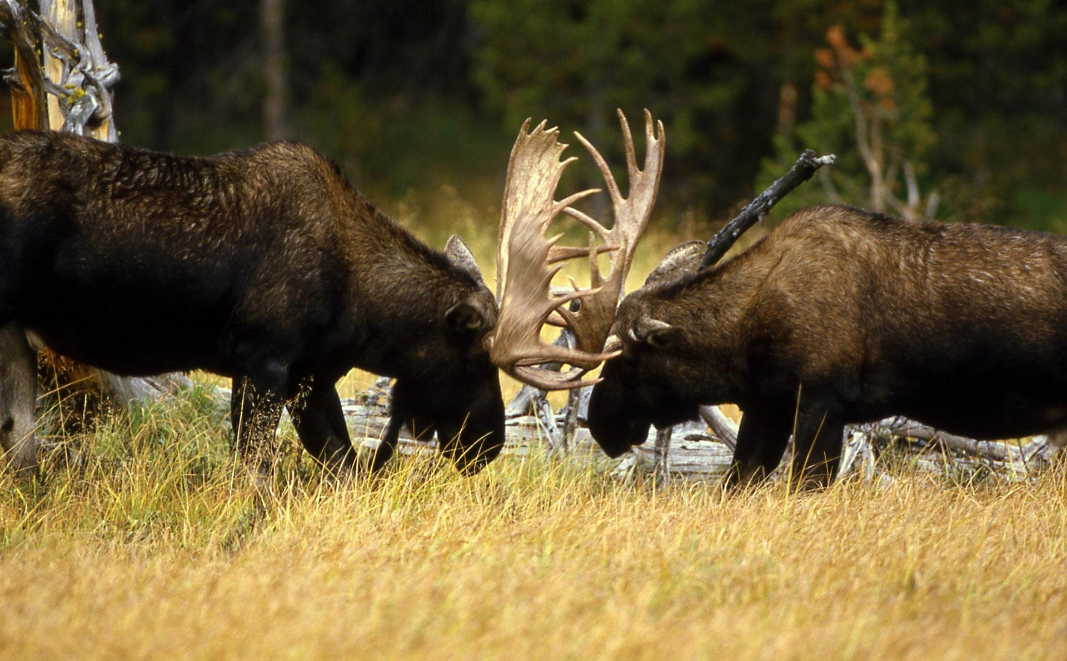
Thesis:
Moose populations in the Adirondacks are limited through factors such as: carrying capacity, realized niche, reintroduction, and overhunting. Our study allows us to compare the factors and determine the most plausible cause of a decrease in moose abundance using literature.
Notes:
Sim

Slide 4
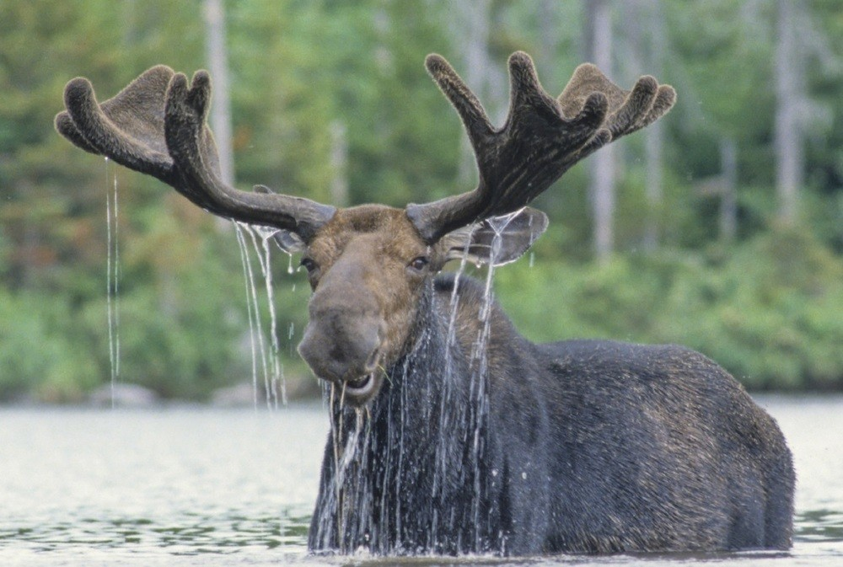
Background of the Adirondack Moose
What do they look like?
What family of wildlife are they related to?
Where is their habitat/landscape?
What is their diet?
What is their reproduction season/cycle?
What are their predators?
What is the highest cause of death?
Courtesy of Wild Republic
Notes:
(Connor)

Slide 5
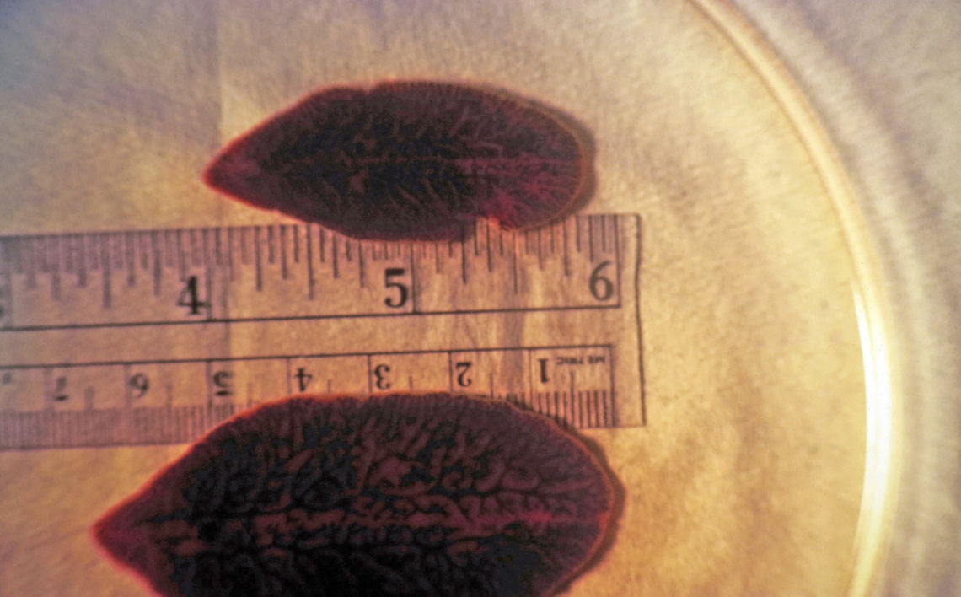
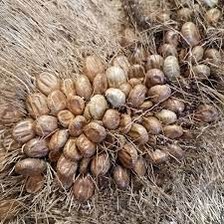
Influencing Factors
Estimated Carrying Capacity
~750 moose
Human factor
Historically extirpated
Reintroduction
Human-moose interactions
Habitat Preferences of moose
Seasonal forage
Temperature stress
White-tailed deer parasites
Ticks (blood loss)
Giant liver fluke (Fascioloides magna)
Brainworm (Parelaphostrongylus tenuis)
More studies needed
Idaho Fish & Game
North Dakota Game & Fish

Slide 6
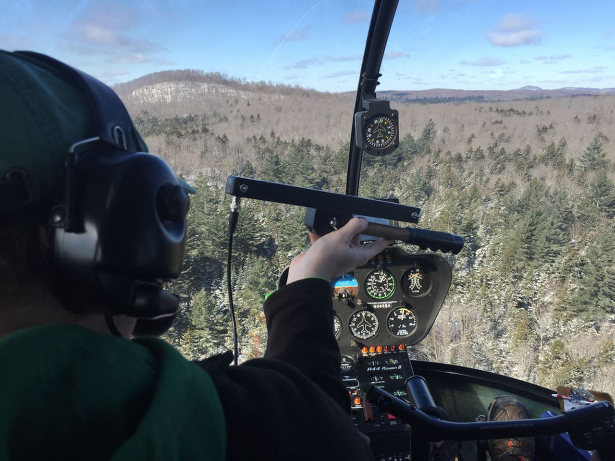

Estimated carrying capacity (Methodology)
There are several ways to estimate moose abundance.
From rigorous field work to at home estimates based solely on Geospatial Data.
Courtesy of David Figura l NYup.com
Courtesy of GeospatialWorld.net

Slide 7
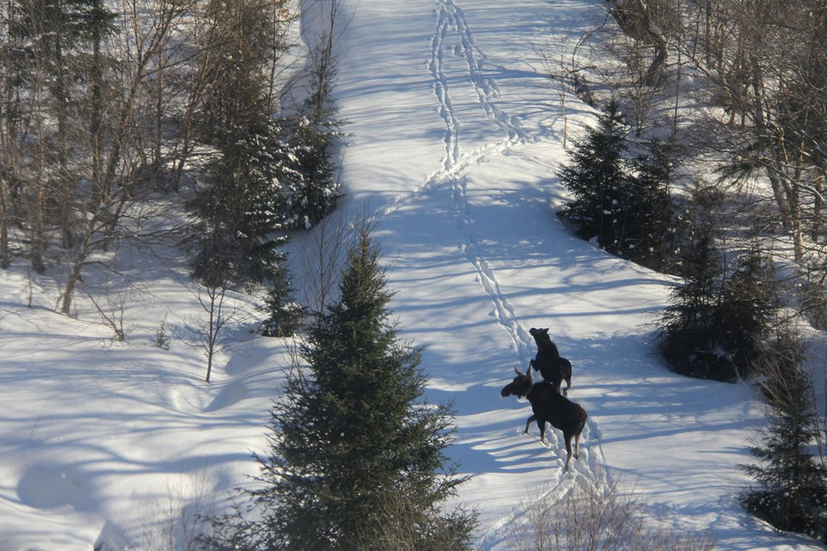
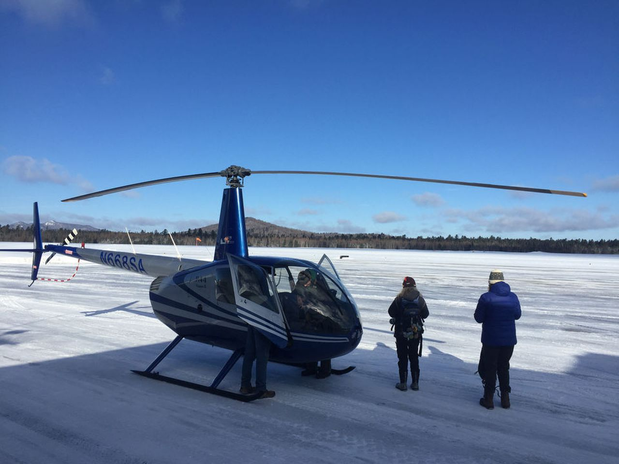
Estimated Carrying Capacity
Aerial Surveys
A transect delineated and flown by a helicopter with several moose spotters on board
A yearly count is maintained
This method has an estimated population size of 656 moose (95% CI = 501–859) currently in the Adirondack Park (Hinton et al. 2022)
All large groups are found in regenerating forests
Why?
Courtesy of David Figura l NYup.com

Slide 8
Estimated Carrying Capacity
Geospatial Data
Determined carrying capacity based on images of land cover in the Adirondacks and moose habitat preference.
Most recently performed in 2022 and provided an estimated carrying capacity of 760 moose (SD ± 428) on average(Kramer et al. 2022) (This lines up with the more rigorous aerial survey data almost perfectly)

Slide 9
Moose Habitat (Vegetative Cover) Preferences
Habitat Preference in Moose depends strongly on browse available to the moose which, in turn, is dependent upon moose physiology (specifically physiology of the snout).
Moose have larger snouts than deer (see board)
How could this impact browsing tendencies?

Slide 10
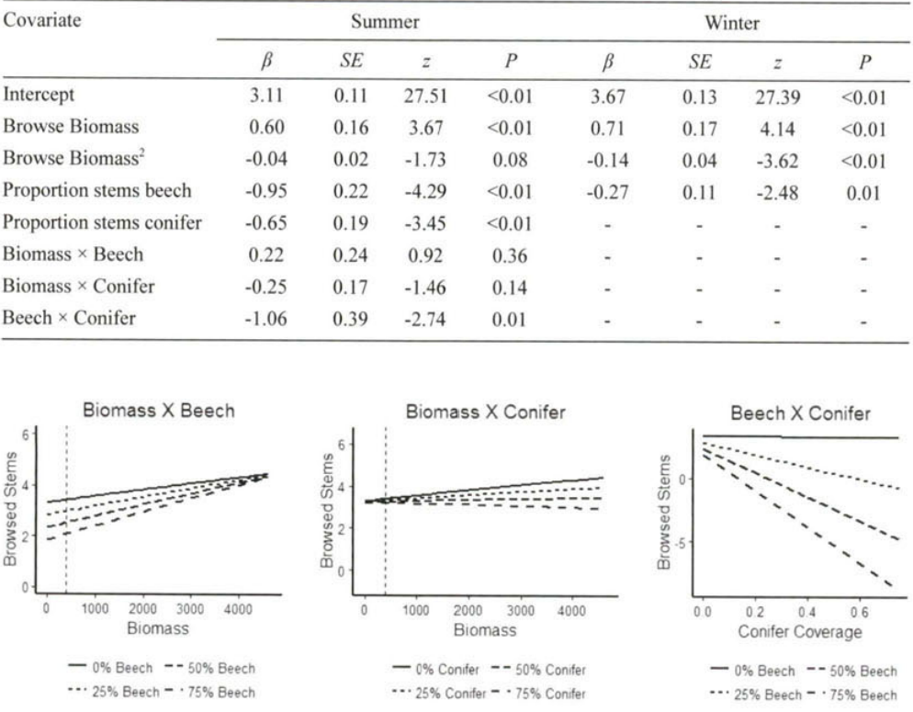
Moose Habitat (Vegetative Cover) Preference
(Peterson et al. 2020)

Slide 11
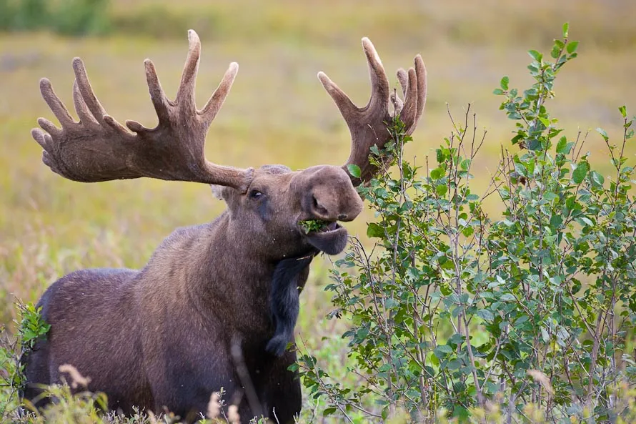
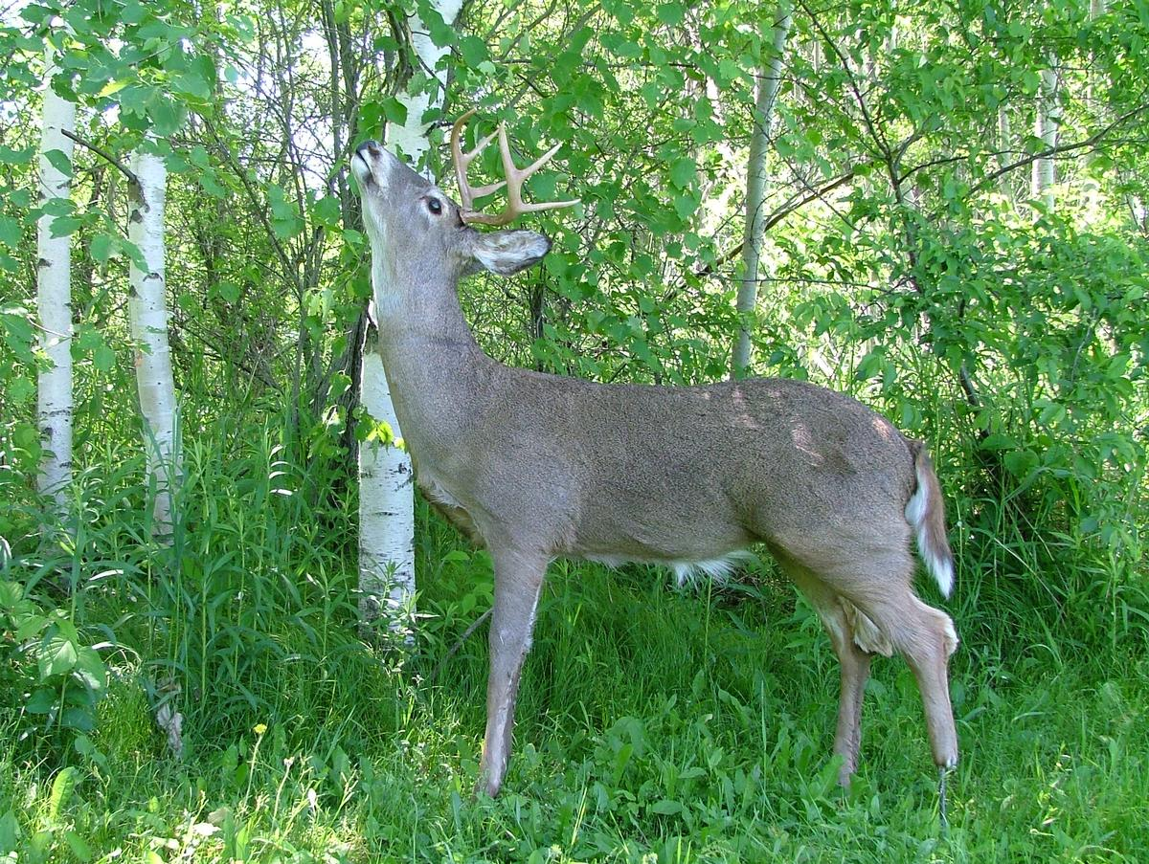
Moose Habitat (Vegetative Cover) Preferences
Courtesy of alaskaphotographics.com
Courtesy of roboticwildlife.com

Slide 12
Moose Habitat (Vegetative Cover) Preference
Moose Physiology forces moose to have to feed in areas of dense forage unlike ungulates like white-tail deer that can be more “choosy” (Frair, 2022)
As such they really on areas where forests are regenerating, where they can easily consume mouthfuls of browse at a time (Frair 2022)
However moose have more preferences than just regenerating forests.

Slide 13
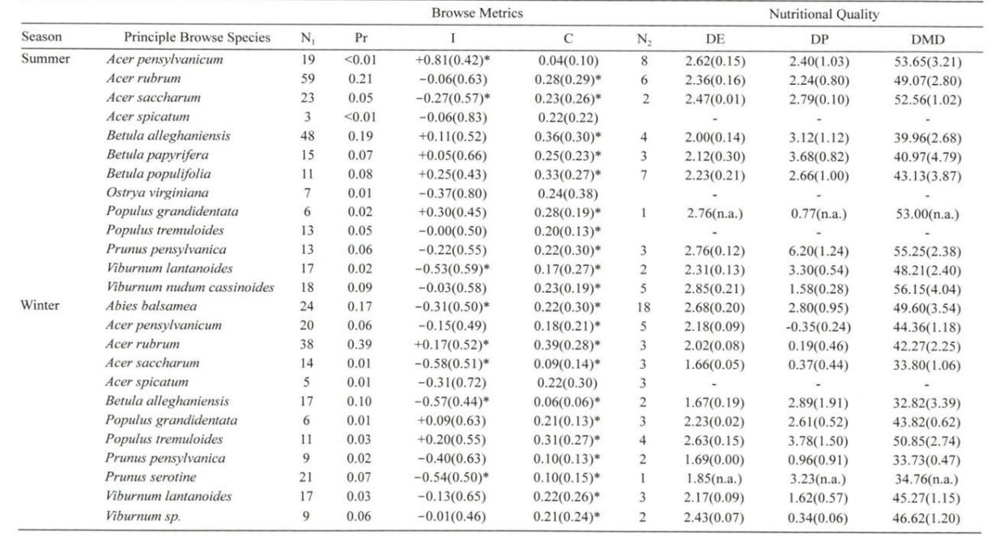
Moose Browse Preference
(Peterson et al. 2020)

Slide 14
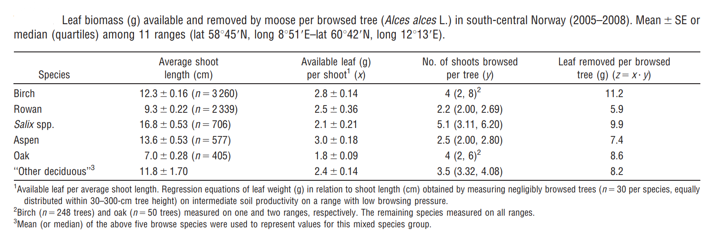
Moose Browse Preference
(Wam and Hjeljord 2010)

Slide 15
Land Cover in ADK vs. New Hampshire
New Hampshire has far more disturbed land than the Adirondack Parks, with it being describe as a moose paradise (Frair, 2022).
The Adirondacks have far less regenerating forest due to disturbed land.

Slide 16
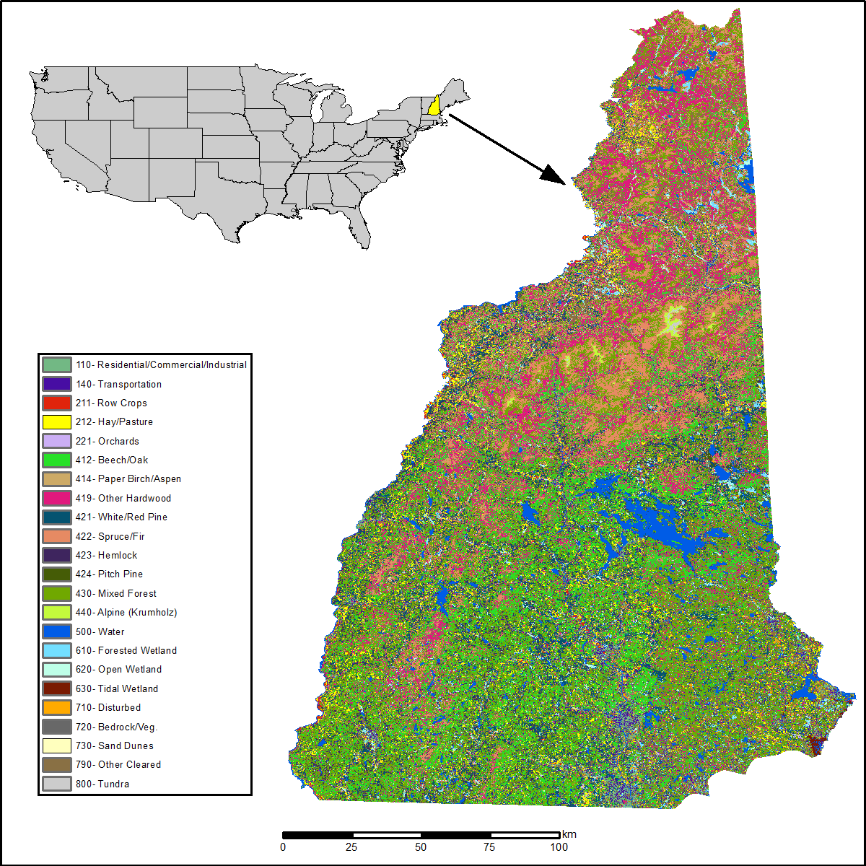
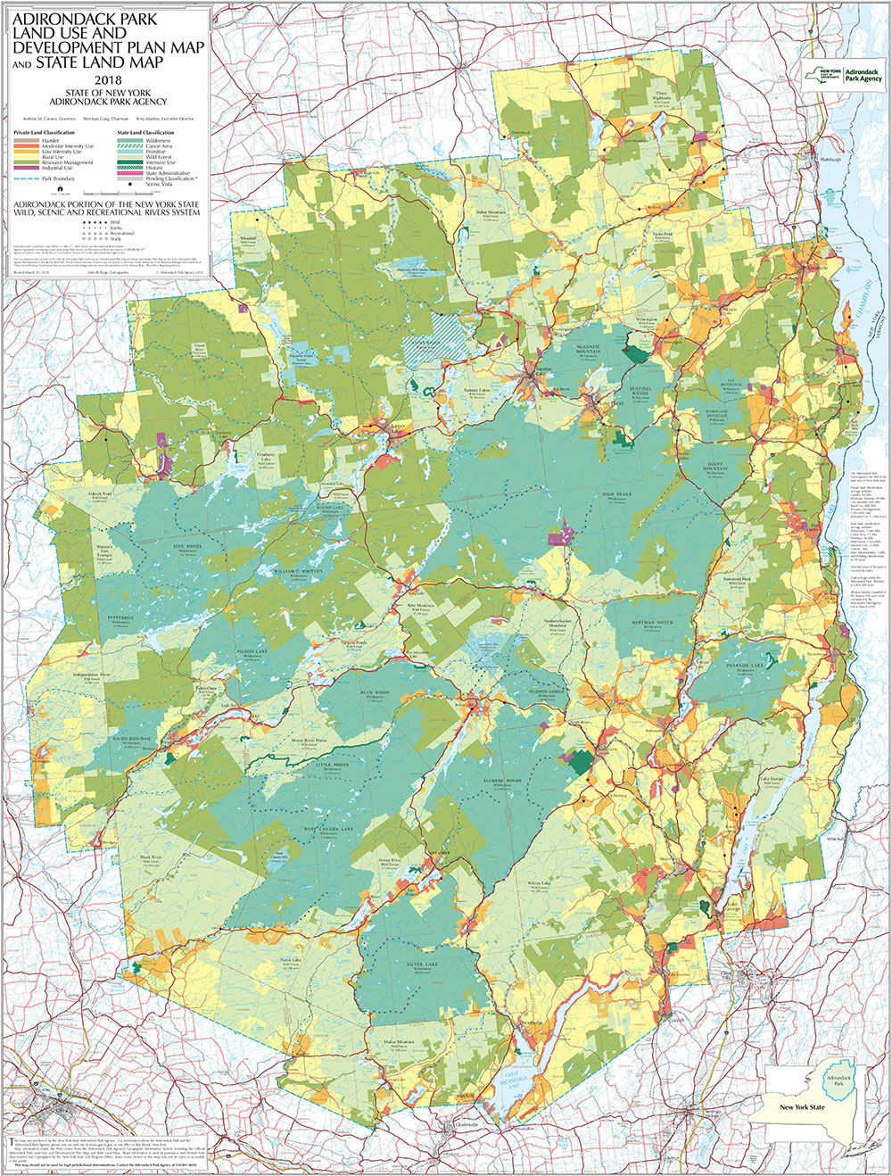
(Justice et al. 2016)
Courtesy of adirondack.maps.arcgis.com

Slide 17
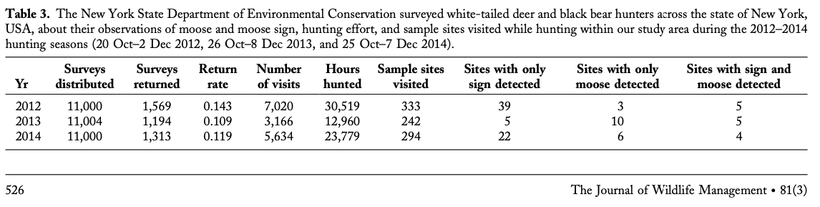
Habitat and Land Cover in Adirondacks
Between 2012 and 2014, “occupancy probability of 0.150 (95% CI 1⁄4 0.076–0.276) in 2012, 0.069 (95% CI 1⁄4 0.045–0.103) in 2013, and 0.081 (95% CI 1⁄4 0.041–0.153) in 2014” (Crum et al. 2017)
Low AIC model result (weight=1)
Preferred land cover is “early successional forest or scrubland, mixed forest, and wetlands” (Crum et al. 2017)
Notes:
Sim: how many occurrences there are
According to moose hunter data in the Adirondacks of moose occurrences.
Sampling sites are made from county borders and national land cover data, about 70k hours in all sites and about 20 visits per site on average.
The model took into account false positives (false detection of moose through index), reduce biases (if identification was accurate) and low density sites. The model used in the study reduced AIC 7s (the biases) to an average of 1.
Detection levels of moose are low between 2012-2014 compared to other years, and can be influenced by movement.
More data from bow hunters earlier in the year can also be beneficial.
From the interview: Jacqueline taught us that ariel survey is the most useful surveying technique, by flying in a helicopter and looking for moose it is the cheapest and best detection process (in comparison to drones or other surveying techniques).

Slide 18
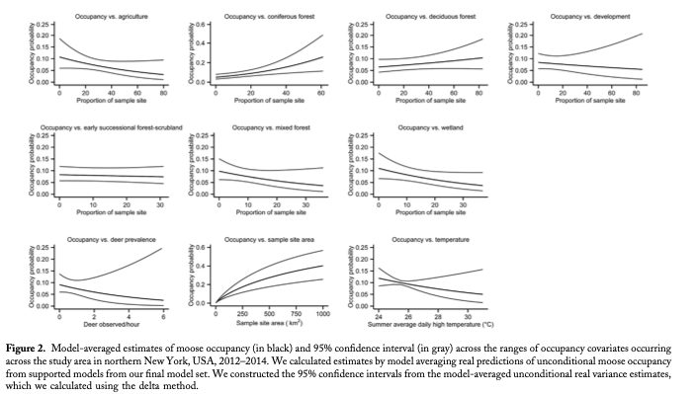
(Crum et al. 2017)
Notes:
Sim: what land cover type the occurrences are in
Middle line of each graph is moose occupancy and two outside lines are 95% confidence intervals.
Furthermore, moose are more likely to occur in deciduous forests, and not likely near deer, human development, and high summer temperatures.
Moose are likely to occur in the Adirondacks and less likely near lake Ontario and Interstate 90.
The preferred land cover types can be found: Adirondack park. But is not preferred at Lake Champlain, and St. Lawrence and Hudson river (human populated areas).

Slide 19
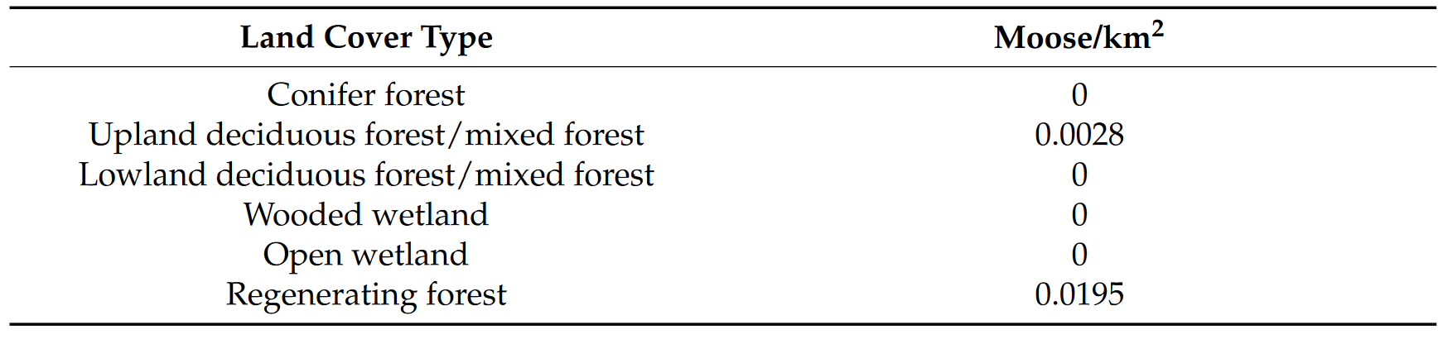
ADK Moose Prevalence by land type
Source: (Kramer et al. 2022)
Notes:
Sim
In a different study done to estimate the carrying capacity of moose per land cover type using remote sensing mixed with literature, the carrying capacity of moose in different land cover types were calculated in Adirondacks between 2015-2018.
Supports the occurrences of moose in deciduous forest from the last slide/study.
There is not enough information to backup but moose may be impacted by a rare land cover type that consists of regenerating forests.
Although new york has a large amount of deciduous forests and wetlands which are ideal for moose habitat, there are other factors as to why moose are not prevalent in new york state.

Slide 20
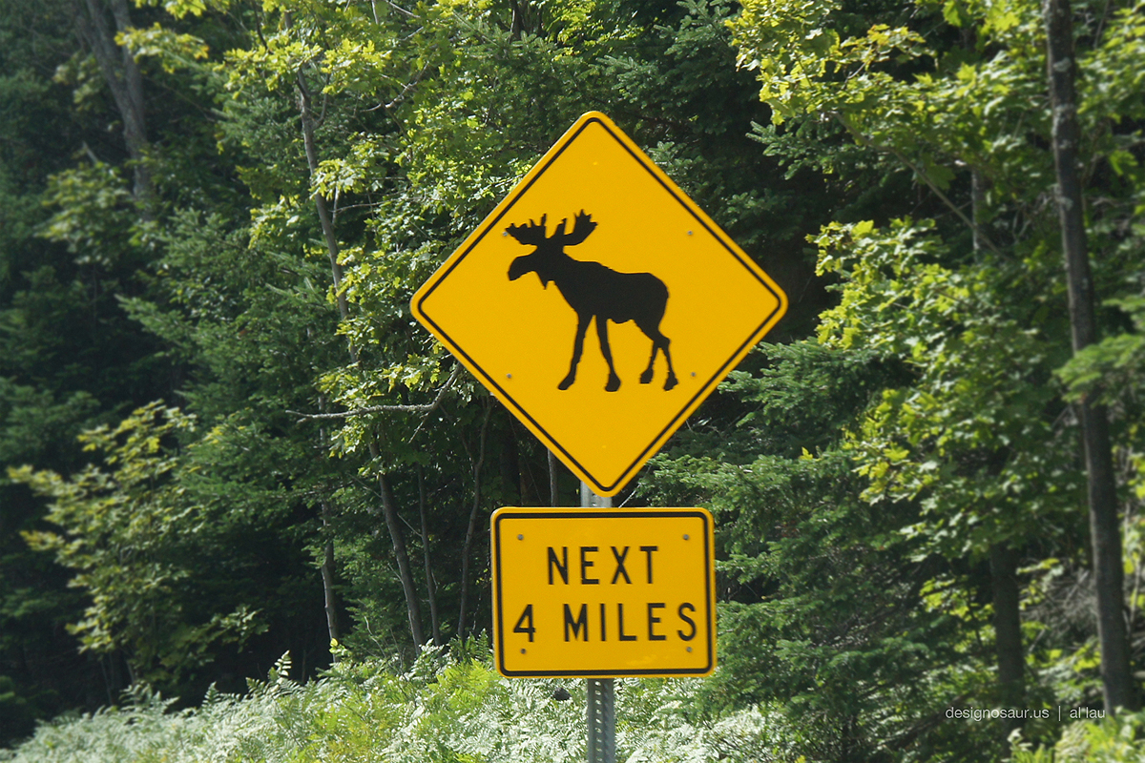
Human Factor
Public support for reintroduction
- vehicle collisions
- hunting
- monetary costs
- agriculture
- deer
- natural repopulation
designosaur.us 2013
Notes:
Vehicle collisions increase with increasing moose populations (often causes moose mortality, not human fatality, but would increase if moose numbers grow - as in NH)
Early 19th century reintroduction effort was not effective in preventing hunting, somewhat disregarded by Adks hunters
Competition for browse wouldn’t limit population, but P. tenuis (brainworm parasite) affects moose (eat more than deer which aren’t affected as much)
Population has increased w/o intervention, just very slowly

Slide 21
Human Factor
Translocation dangers (heat, exhaustion, etc.)(selecting moose unfamiliar with release range)
Interference leading to fewer fires = less of the preferred habitat of moose
Notes:
-transport and lack of prescribed burns

Slide 22
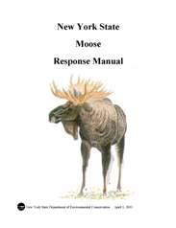
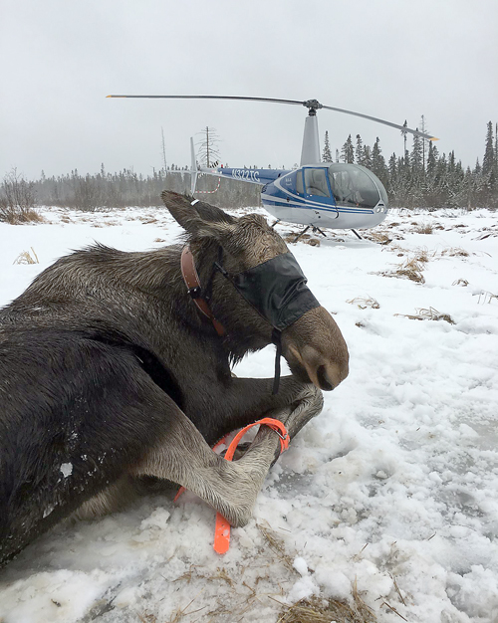
Relationship to North American Model
Funds
No hunting, less funds
Lotto hunting season?
Management
More research needed
No ADK moose management plan
More moose, more disease?
NYS DEC
Adirondack Daily Enterprise

Slide 23
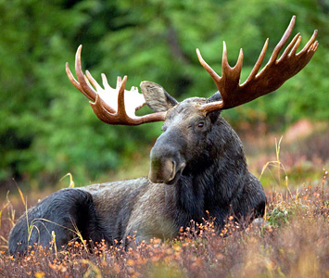
What to do?
The low population is suitable for the current conditions
Carrying capacity is close to population numbers
Threats of disease
Limiting habitat fragmentation
Layout of roads, accessibility to waters, increasing connectivity of regenerative areas-(prescribed burns?)
Manage wolf and bear populations (some prey on moose calves)
Possibly introducing trophy hunts
Keeping population at determined carrying capacity
Way to raise funds
Work with the public to increase understanding
Curtesy of biological diversity.org
Notes:
The adirondacks cannot support significantly more moose
potential to increase the population not be available now
Consider the carrying capacity-available food, connectivity, climate change
Threats of disease
Exceeding carrying capacity= a more unhealthy population
Moose are not good groomers, they are at increased risk for tick as they continue to increase in NY
Limiting habitat fragmentation of preferred habitat
Building of roads to avoid- cross less highways than forest roads, still attracted to roads for sodium-rich vegetation (https://wildlife.onlinelibrary.wiley.com/doi/abs/10.2193/2008-063),
access to waters- need to cool off in the summers but there's a tendency to build infrastructure around lakes
Need connected Regenerative forests- Prescribed Burns as a way to assure regeneration
Manage wolf and bear populations (some prey on moose calves)
Work with the public to increase support
-moose perceive dogs as wolves. This perceived threat leads to the moose become stressed and aggressive
-Yelling at a moose may encourage them to charge
Hunting of moose should not be occurring- but it is something that should be considered- both the be limited as of now, and if the population were to flourish in the future how would it be managed
Moose pic-Male_Moose_Ryan_Hagerty_USFWS.jpg

Slide 24
Conclusion
There aren’t many moose in NY, and that’s okay
Food availability
Habitat suitability, fragmentation
Fertility and parasites
Many policies prevent management for moose populations
Mainly the forever wild
Studies of moose are limited
Exist in limited places
Difficult to work with
Expensive
Notes:
There aren’t many moose in NY, and that’s okay
Food availability
Habitat suitability
Fertility and parasites( neospora caninum)
Many policies prevent management for moose populations
Mainly the forever wild
Studies of moose are limited
Exist in limited places
Difficult to work with (large animals, they can do damage, also weird things like diving 30 feet into the water)
Expensive (aerial studies that take a long time, many people, and sometimes equipment like thermal sensors)

Slide 25
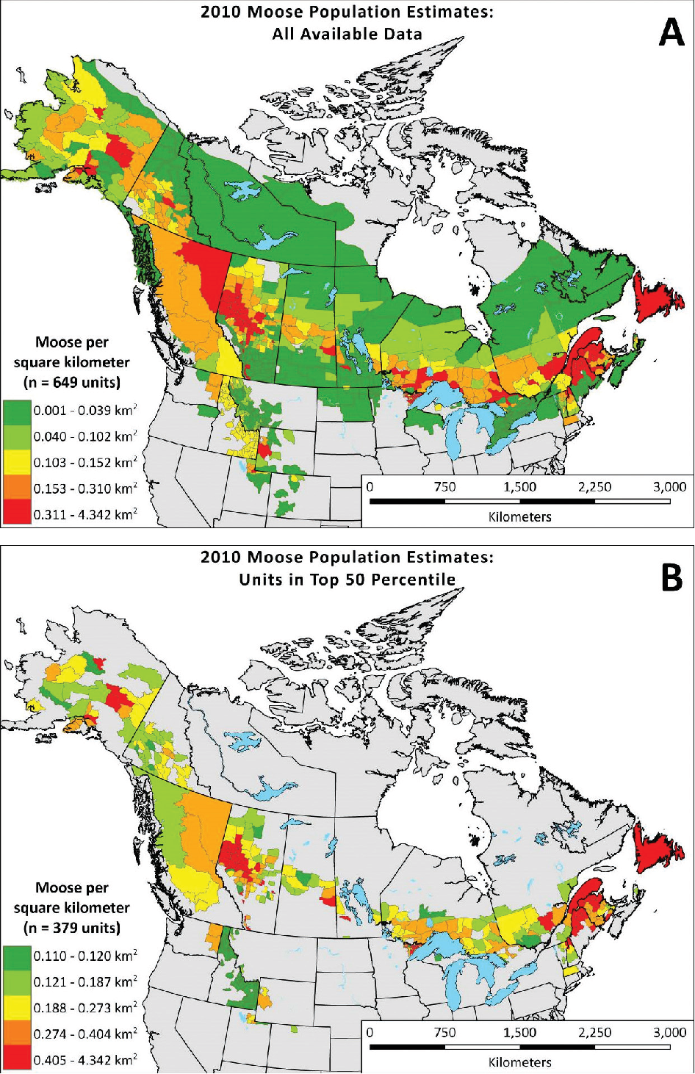
Conclusion
The Adirondacks habitat suitability for Moose differs from other geographically similar areas
Possible temperature differences
Preferred habitat availability
Lacking public support
Feasibility of reintroductions
They have not been successful, and are not bound to be successful
Any way to make the reintroduction work?
Have to address the ecosystem first
Time
Accept that it’s not a good choice
Notes:
The Adirondacks habitat suitability for Moose differs from other geographically similar areas
Possible temperature differences
Climate change
Becoming less of a northern hardwood forest (preferred habitat)
Struggle when temps. Reach above 80 F
It's becoming more common for northern NY to reach those temps.
Access to lakes to swim in might be limited do to habitat fragmentation (everyone wants houses on the lake)
Preferred habitat availability
Lacking public support
New Hampshire and vermont are more suitable for moose and can support a higher carrying capacity
Feasibility of reintroductions
They have not been successful, and are not bound to be successful
Any way to make the reintroduction work?
Relate to NA model
Work with where they already are and expand from there- there is strong fidelity to already established home ranges (https://www.jstor.org/stable/3801246?seq=5#metadata_info_tab_contents)
Time-evidence of starting to naturally repopulate in areas of
Small scale corridors over the roads they’re more inclined to cross
figure-https://www.semanticscholar.org/paper/EXPANDING-GIS-ANALYSES-TO-MONITOR-AND-ASSESS-NORTH-Jensen-Smith/c89b43141aefa15672d3a6b40c4341babe70a646

Slide 26
Citations
Bjorneraas, K., E. J. Solberg, I. Herfindal, B. V. Moorter, C. M. Rolandsen, J.-P. Tremblay, C. Skarpe, B.-E. Saether, R. Eriksen, and R. Astrup. 2011. Moose (Alces alces) habitat use at multiple temporal scales in a human-altered landscape. Wildlife Biology 17:44–55.
Crum, N. J., A. K. Fuller, C. S. Sutherland, E. G. Cooch, and J. Hurst. 2017. Estimating Occupancy Probability of Moose Using Hunter Survey Data. The Journal of Wildlife Management 81:521–534.
Drucker, D. G., K. A. Hobson, J.-P. Ouellet, and R. Courtois. 2010. Influence of forage preferences and habitat use on ¹³ C and ¹⁵ N abundance in wild caribou ( Rangifer tarandus caribou ) and moose ( Alces alces ) from Canada. Isotopes in Environmental and Health Studies 46:107–121.
Frair, J. L.. 2022. Personal Interview
Haase, C. G. 2010, May. Characterizing Critical Thermal Environments for Moose (Alces alces) in the Adirondack Mountains of New York.
Hinton, J. W., R. E. Wheat, P. Schuette, J. E. Hurst, D. W. Kramer, J. H. Stickles, and J. L. Frair. 2022. Challenges and opportunities for estimating abundance of a low-density moose (Alces alces) population. The Journal of Wildlife Management 86:e22213.
Justice, D., A. K. Deely, and F. Rubin. 2016. Land Cover and Land Use Classification for the State of New Hampshire, 1996-2001:27.14685 MB.
Kramer, D. W., T. J. Prebyl, N. P. Nibbelink, K. V. Miller, A. A. Royo, and J. L. Frair. 2022. Managing Moose from Home: Determining Landscape Carrying Capacity for Alces alces Using Remote Sensing. Forests 13:150.
Peterson, S., D. Kramer, J. Hurst, and J. Frair. 2020. Browse Selection by Moose (Alces alces) in the Adirondack Park, New York. Alces 65:107–127.
Wam, H. K., and O. Hjeljord. 2010. Moose (Alces alces) Summer Diet From Feces and Field Surveys: A Comparative Study. Rangeland Ecology and Management 63:387–395.

